Slide 1



AMAZON
FINANCIAL
INSIGHTS
01

Slide 2




TABLE OF
Contents
01
Company Overview
02
About Dataset
03
Dashboard
04
Analysis
05
Recommendation
06
Conclusion
02

Slide 3

COMPANY OVERVIEW
Amazon - Global leader in e-commerce, cloud computing, and AI.
Key focus areas: Retail, AWS, Prime services.
Innovative & customer-centric, operating worldwide.
03

Slide 4

ABOUT DATASET
Dataset Overview:
Sales and Expenses (2015-2017), customer demographics, product details, returns, and territory.
Key Components:
Yearly Sales.
Customer segments.
Product categories and subcategories.
Returns and regional data.
Applications:
Analyzing sales trends, customer behavior, and regional performance.
04

Slide 5

DATA PROCESSING AND TOOLS USED
Data Collection: Gather Amazon’s financial and sales data.
Data Cleaning: Structure and refine data for accuracy.
Data Analysis: Compute key metrics and identify trends.
Data Visualization: Build interactive Power BI dashboards.
Predictive Analysis: Forecast trends using historical data.
Deployment: Publish insights and summarize findings.
Methodology
Marketing Spend
Gross profit
Net profit ,Net Profit Margin
Profit Margin %
Revenue-Cost-ratio
Sales Growth
Total Expenses ,Total Orders ,Total Revenue
Region Revenue
Measures Created
05

Slide 6
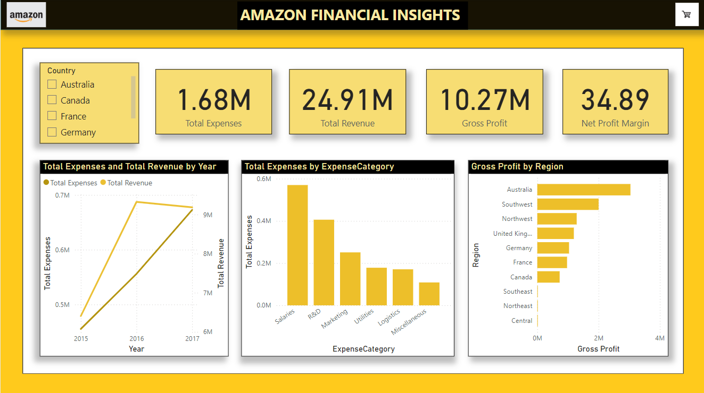
DASHBOARD
07

Slide 7
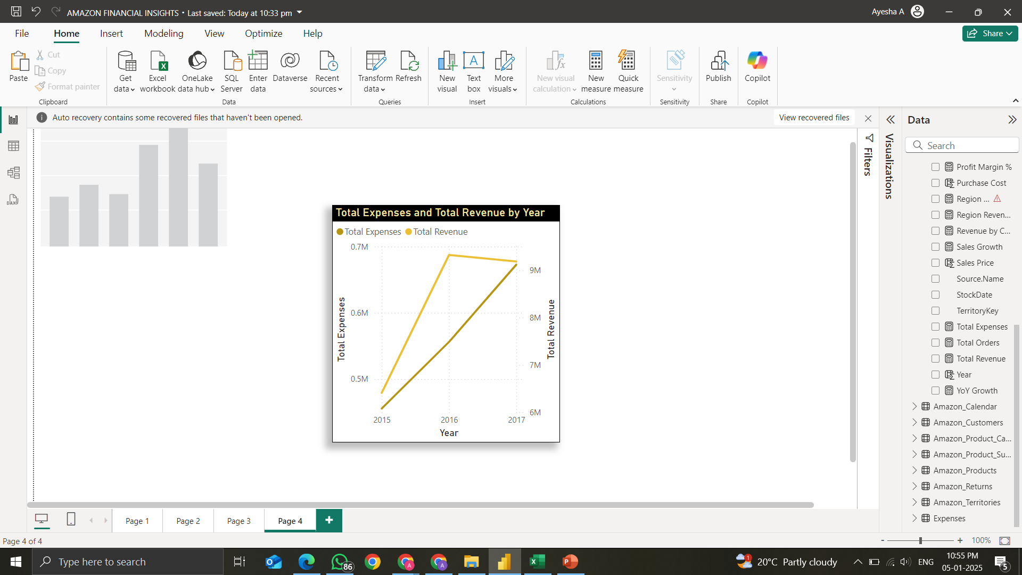
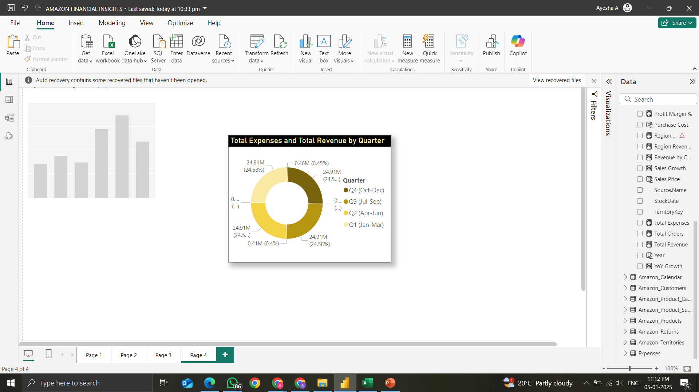
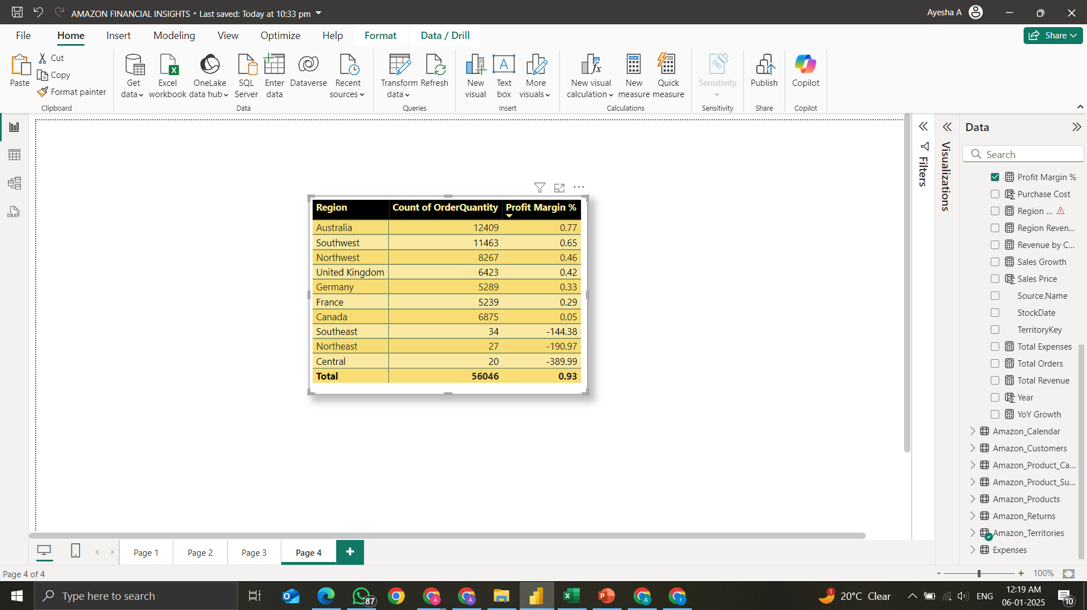
ANALYSIS
Revenue and Expense Trends:
Revenue peaked at $9.3M (2016) but dipped slightly in 2017 ($9.18M), while expenses remained lower, ensuring profitability. Q4 (27.07%) sees the highest expenses, highlighting seasonal spending trends.
Profitability Insights:
Australia leads in profit margins (0.77%), while Central incurs the highest losses (-389.99%). Profit margins vary significantly across product categories, with some generating strong returns, while others, like Southeast and Northeast regions, show negative profitability.

Slide 8
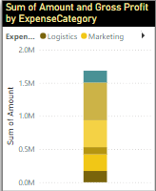
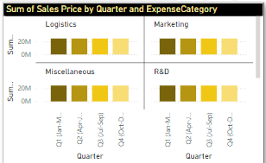
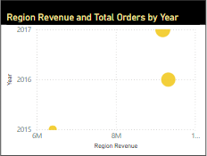
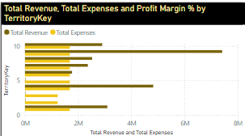
ANALYSIS
Cost Efficiency:
Salaries (highest expense) and R&D significantly impact profitability, while logistics and marketing contribute moderately. Seasonal spikes in expenses, especially in Q4 (27.07%), align with peak sales periods, suggesting a strategic investment in operations and demand surges.
Regional Performance:
Australia and Southwest lead in profitability, while Central and Northeast operate at a loss. Regions with a higher revenue-to-expense ratio, like Australia, maximize cost efficiency, whereas Southeast and Central show negative margins, indicating inefficiencies.

Slide 9
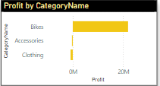
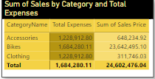
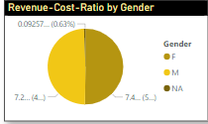
ANALYSIS
Product Analysis:
Bikes and Accessories drive the highest profits, while categories like Clothing and some smaller subcategories incur high expenses with lower sales. Identifying and optimizing these underperforming products can enhance profitability.
Customer and Territory Insights:
Customer demographics vary in profitability across territories, with high-value segments driving stronger margins. Premium and repeat customers contribute the most revenue relative to costs, while some segments show lower efficiency, indicating optimization potential.

Slide 10


Recommendations
Expand in High-Growth Regions
Reduce Returns
Reallocate Expenses
Use Seasonal Trends
Promote High Margin Products
11

Slide 11

Strong revenue & profit margins with growth potential.
Bikes & Australia lead sales; Southeast needs improvement.
Salaries & R&D dominate costs; optimization needed.
Expanding high-growth regions & reducing inefficiencies can boost profitability.
Data-driven insights enhance sales & efficiency.
CONCLUSION
12

